Slide 1
Measuring Synchrony in Task-Based Dialogue with Context Vectors
Tom Tye 18323900
tyet@tcd.ie

Slide 2
Presentation Structure
Background
State of the Art
Implementation/Challenges
Quick Demonstration
Next Steps

Slide 3
Background – Linguistic Background
This is a linguistics/NLP-focused project, I will do my best to explain terminology as it comes up
Syntactic & semantic priming effects well studied for decades
These priming effects have many beneficial uses in natural language dialogue

Slide 4
Background – Work of Reverdy/Vogel
Previous work by Justine Reverdy and Dr. Carl Vogel from 2017 sought to investigate the extent to which semantic self-repetition and other-repetition in dialogue was indicative of ‘dialogue success’- in essence, mutual understanding
This project can be seen as a continuation of their work

Slide 5
Background – Work of Reverdy/Vogel
How did they set up their experiment?
First, the corpus:
HCRC Map Task Corpus;
128 Dialogues
‘Task-Based’ dialogues – useful as task success can be taken as a measure of dialogue success
Mix of familiar/unfamiliar dialogue participants
More useful features (eye contact, participant gender)

Slide 6
Background – Work of Reverdy/Vogel
The method:
Treat/format the dialogues
Considering current turn and previous turn of each participant, take counts of repeated n-grams up to n=5
This is repeated for several different linguistic ‘levels’; Token, Lemma, Part-of-Speech

Slide 7
Background – Work of Reverdy/Vogel
This analysis was also performed on the same dialogues with randomized turn order
In cases where proportion of repetition exceeded that which could be expected from randomized dialogue, conclusions were then drawn in regards to how this repetition correlated with task success

Slide 8
Background – Work of Reverdy/Vogel
While this analysis produced enlightening results with regards to quantifying engagement and mutual understanding and was received well, there are certain semantic elements of speech that the method could not capture
For example, the role of polysemy, pronoun semantics, etc

Slide 9
State of the Art – Context Vectors
Context vectors are a modern, powerful tool in NLP
Vectors associated with the context in which certain tokens appear
Seeks to emulate human meta-semantic knowledge- can be used to model polysemy etc.

Slide 10
State of the Art – Context Vectors
Context vectors have been a hot topic of NLP research in recent years
Word2Vec - Mikolov et al. 2013
GloVe – Pennington et al. 2014
ELMo - Peters et al. 2018
BERT – Devlin et al. 2018

Slide 11
Implementation - Challenges
Entirely new field of study for me – lots of time had to be spent researching background of the field/terminology/foundational papers not necessarily project-relevant
Learning new languages & tools – learning how to use R, Perl, Python took some time
Working with ML systems used to pre-train word vectors had a learning curve

Slide 12
Implementation – Design Overview
Treat the dialogues – remove header lines, format spacing
Create 10 extra dialogue sets with randomized turn order
Tag sentences with metadata (speaker, eye contact, familiarity, dialogue ID, deviation score)
Use pre-trained ML model to generate sentence-level embeddings and assign these to sentences

Slide 13
Implementation – Design Overview
Assign to each sentence the cosine similarity between its vector and the vectors representing prior turns of participants
HSD Tukey Test to gauge similarity levels of actual vs. randomized dialogue
Meta-analysis of similarity effects and other variables (familiarity, eye contact etc.) vs. deviation score

Slide 14
Aside – Word vs. Sentence Vector Representations
The overwhelming majority of context vector models generate embeddings at word level – i.e. 1 vector represents 1 word
For the purposes of the task, we need sentence level embeddings – 1 vector represents 1 sentence
Currently, methods of ‘pooling’ word embeddings into sentence-level representations are quite limited, generally mean pooling
More in-depth methods of computing sentence embeddings are computationally prohibitive

Slide 15
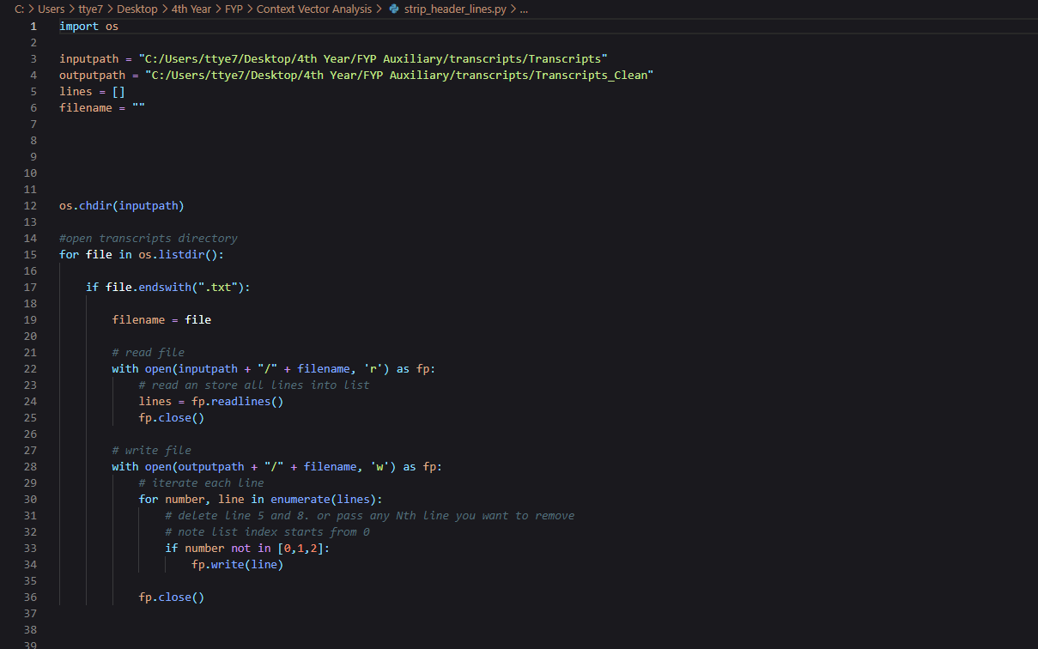
Implementation – Code Demonstration
Treating the dialogues with Python

Slide 16
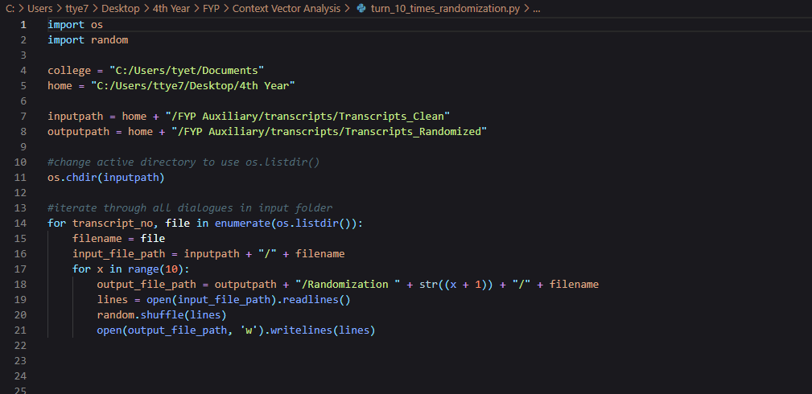
Implementation - Code Demonstration
Creating dialogues of randomized turn order

Slide 17
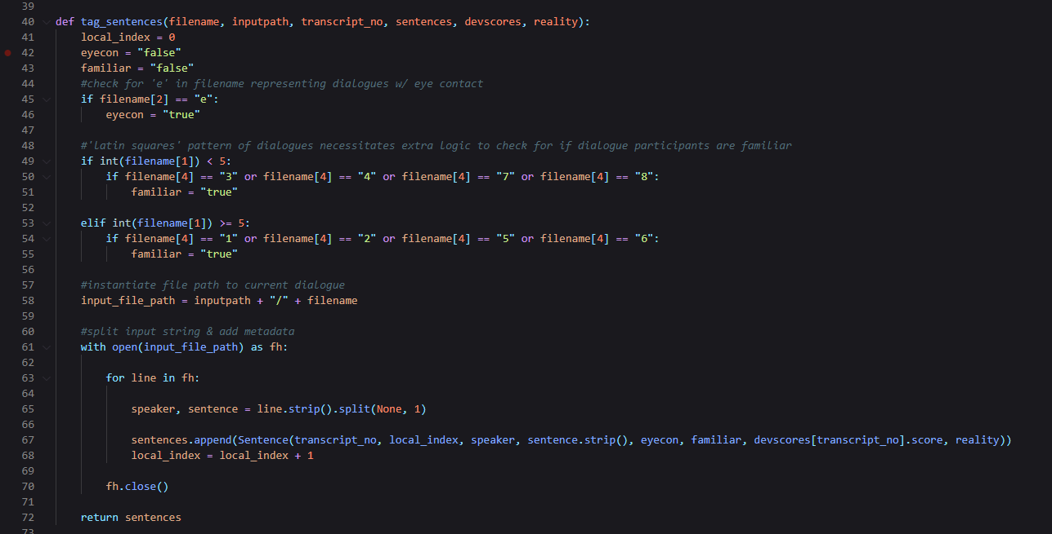
Implementation - Code Demonstration
Tagging sentences w/ metadata

Slide 18
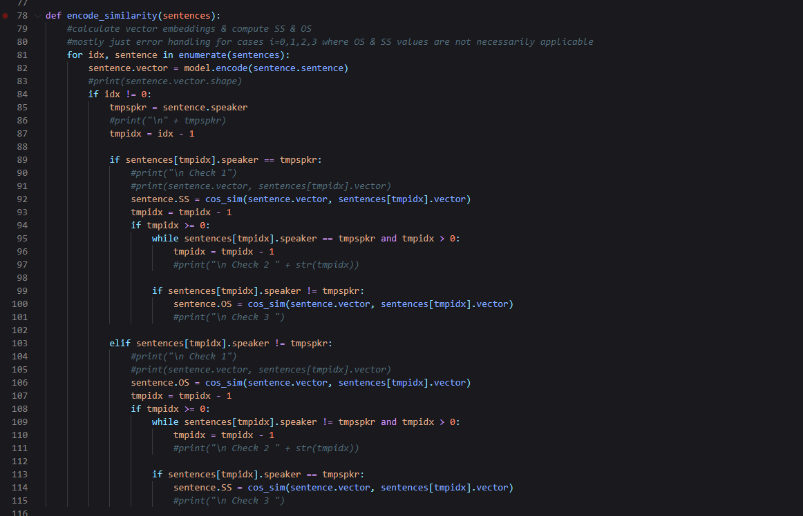
Implementation - Code Demonstration
Generating sentence embeddings, calculating cosine similarity for similarity scores

Slide 19
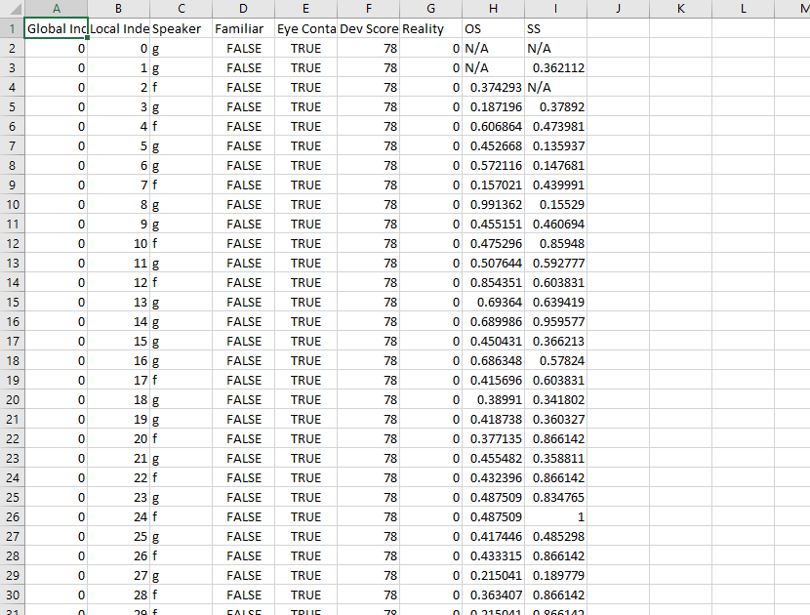
Implementation - Code Demonstration
CSV output after adding metadata and calculating similarity scores

Slide 20
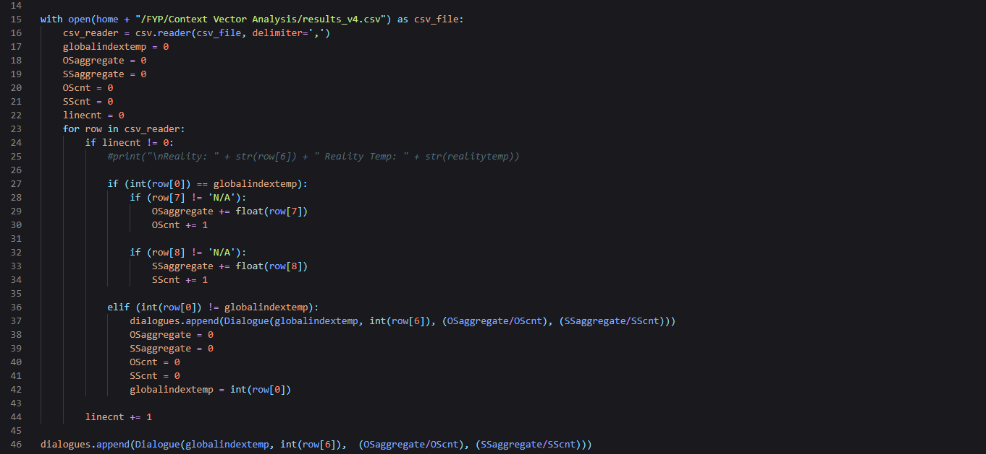
Implementation - Code Demonstration
Mean averaging of similarity values by dialogue

Slide 21
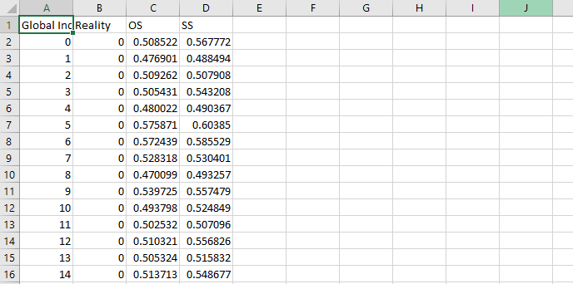
Implementation - Code Demonstration
CSV output after mean averaging

Slide 22
What’s Next?
Still to be implemented:
HSD Test
Meta Analysis
And of course, writing the report

Slide 23
Sources
‘Linguistic Repetitions, Task-based Experience and A Proxy Measure of Mutual Understanding’
Reverdy & Vogel 2017
doi: 10.1109/coginfocom.2017.8268278
‘Measuring Synchrony in Task-Based Dialogues’
Reverdy & Vogel 2017
doi: 10.21437/interspeech.2017-1604

Slide 24
Questions ?

Slide 25
Thank You

